Slide 1

SUMMER INTERNSHIP REVIEW AND PRESENTATION
BLOOD MOBILE SYSTEM

Slide 2

BLOOD MOBILE SYSTEM
Mrs. V VIJAYA MADHAVI
M. SRI GANESH ARYA 245318733155
G. VISHAL 245318733139
M V S. PRANAVI 245318733153

Slide 3
Contents
Abstract
Introduction
Tools and Technologies Implementation
System/User requirements contributions
System Design
Conclusion of the Project

Slide 4
Abstract
The basic building aim is to provide blood donation service to the city recently.
Blood Mobile System (BMS) is a Web-based application that is designed to store, process, retrieve and analyze information concerned with the administrative and inventory management within a blood bank.
This project aims at maintaining all the information pertaining to blood donors, different blood groups available in blood bank and help them manage in a better way, to provide transparency in this field, make the process of obtaining blood from a blood bank hassle-free and corruption-free and make the system of blood bank management effective.

Slide 5
Introduction
The project blood mobile system is known to a pilot project that is designed for the blood bank to gather blood from various sources and distribute to the needy people who have high requirements for it.
The software designed to handle the daily transaction of the blood bank and search the details when required. It also helps the details of the donors, blood collection details as well as blood issued reports.
It will help us to find the blood group with its most efficient time to take care of blood and it easier to hand over the blood to the hospital to help to get blood on time.

Slide 6







Tools and Technologies Implementation
Python
SQLite
Python Flask
Bootstrap
HTML
CSS
JavaScript

Slide 7
System Requirements
Hardware Requirements
PROCESSOR : Intel Pentium or Higher Version
RAM : Minimum 4GB
HARD DISK : 60GB and above
Software Requirements
SOFTWARE : Python 3.3 or greater
DATABASE : SQLite
FRAMEWORK : Flask 1.1.1, Bootstrap
SUPPORTED BROWSERS : Google Chrome / Mozilla Firefox / Internet Explorer
EDITOR : Visual Studio Code
OPERATING SYSTEM : Windows or MAC OS or Linux

Slide 8
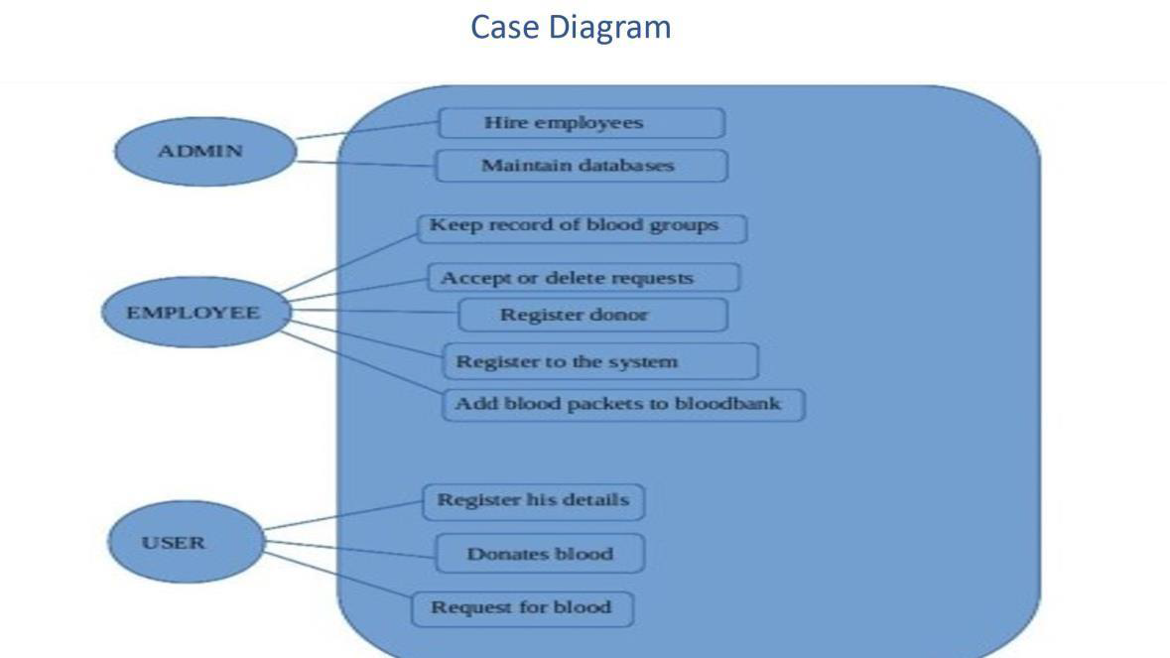
System Design

Slide 9
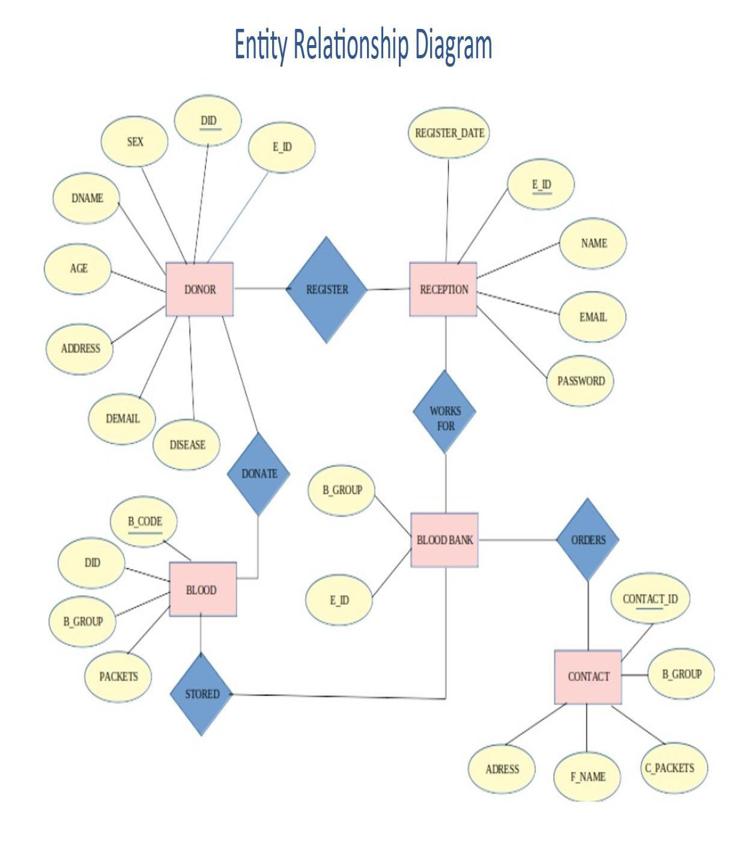

Slide 10
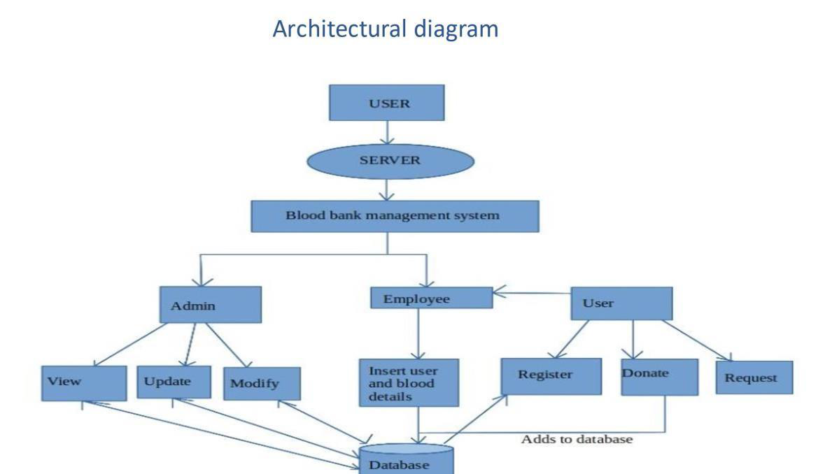

Slide 11
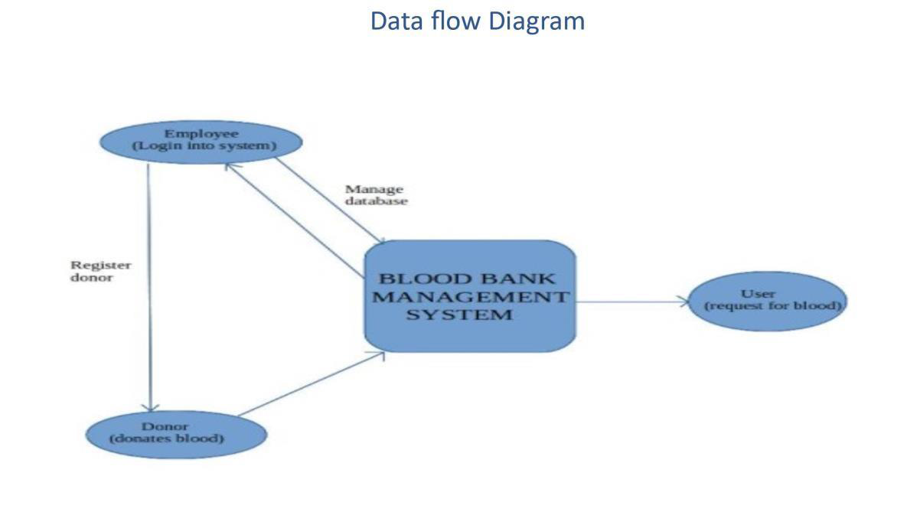

Slide 12
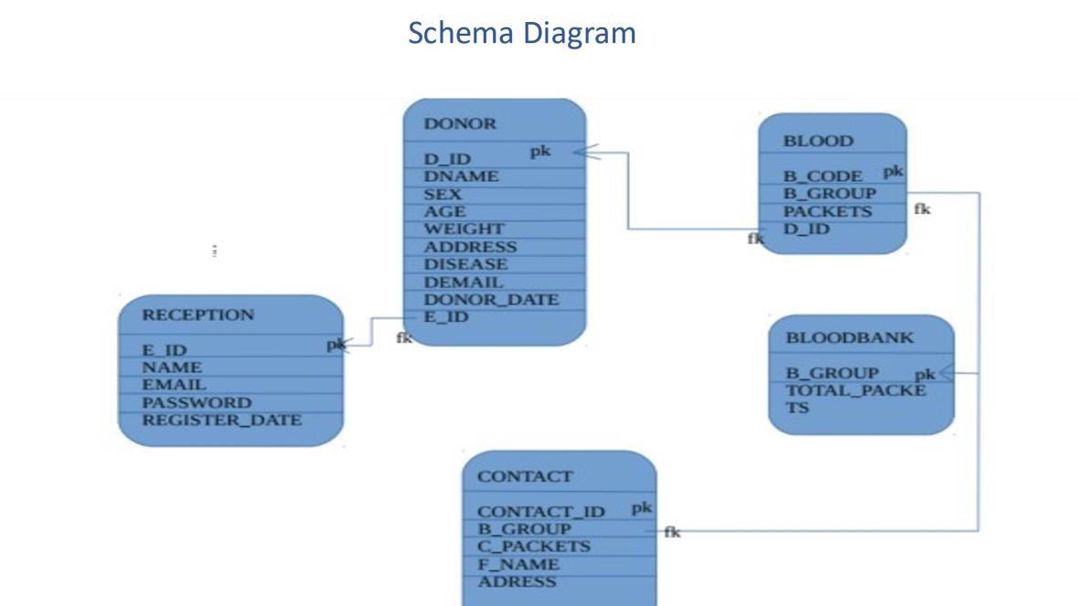

Slide 13
Conclusion
Based on results, this study concluded that the blood bank management system is much better than the manual system.
The findings showed that respondents prefer to use online blood bank management system rather than the manual system because it offers many advantages and benefits that lead to its effectiveness, and efficiency.
Because of the increased confidence on the users on the system, it can be concluded that the online blood bank management system enhances blood transfusion safety because it provides better ways of handling the various processes in blood bank.

